Slide 1
Magical Mathematics
Or, if you prefer: What is all this stuff “good for.”
From Mind Reading to DNA Reading, Code Reading, and Helping Robots Find their Way.

Slide 2
The Trick
2H, QH, 9H, KD
JC, 8D, 10D, 5S
7C, 6D, AS, 2D
5C, 3C, 4C, 7S
2H, QH, 9H, KD
JC, 8D, 10D, 5S
7C, 6D, AS, 2D
5C, 3C, 4C, 7S

Slide 3
De Bruijn
11110110010000
De Bruijn Cycle: circular string of length 2^{n} such that a sliding window of n bits gives each length n bit string exactly once.

Slide 4
De Bruijn – Window 4
0000
00001
000010
0000100
00001001
000010011
0000100110
00001001101
000010011010
0000100110101
00001001101011
000010011010111
0000100110101111

Slide 5
0000100110101111
2H, QH, 9H, KD
JC, 8D, 10D, 5S
7C, 6D, AS, 2D
5C, 3C, 4C, 7S
0 0 0 0
1 0 0 1
1 0 1 0
1 1 1 1

Slide 6
Without the Memorization
A | 001
2 | 010
3 | 011
4 | 100
5 | 101
6 | 110
7 | 111
8 | 000
suit |  | value
x₁ | x₂ | x₃ | x₄ | x₅
Clubs | 00
Spades | 01
Diamond | 10
Heart | 11

Slide 7

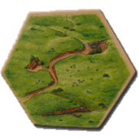
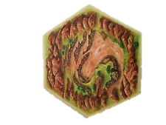
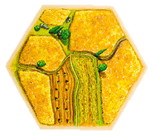
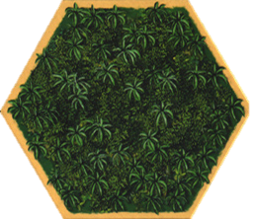


Slide 8
6
2
5
5
3
4
4
10
11
8

Slide 9

5
2
6
5
3
4
4
10
11
8

Slide 10
5
2
6
5
3
4
4
10
11
8

Slide 11
5
2
6
5
3
4
4
10
11
8

Slide 12
Window of 4
1 | 1 | 0 | 1
0 | 0 | 0 | 1
1 | 0 | 0 | 0
1 | 0 | 1 | 1

Slide 13
Window of 4
1 | 1 | 0 | 1
0 | 0 | 0 | 1
1 | 0 | 0 | 0
1 | 0 | 1 | 1

Slide 14
Window of 4
1 | 1 | 0 | 1
0 | 0 | 0 | 1
1 | 0 | 0 | 0
1 | 0 | 1 | 1

Slide 15
Window of 4
1 | 1 | 0 | 1
0 | 0 | 0 | 1
1 | 0 | 0 | 0
1 | 0 | 1 | 1

Slide 16
How Else Can this be used?
Robotics
Digital Pens
Window 3x3, 2⁹
Window 10x10, 2¹⁰⁰

Slide 17
How Else Can this be used?
More digits
2x3 with 3⁶ = 729

Slide 18
Codes
Basics:
Message | 001000000101001100010000
Corruption String | 011010101110100110110101
Coded Message | 010010101011101010100101
Coded Message | 010010101011101010100101
Corruption String | 011010101110100110110101
Message | 001000000101001100010000

Slide 19
Corruption String
Can choose from place in a de Bruijn squence
8 bit word – 2²⁰ possibilities

Slide 20
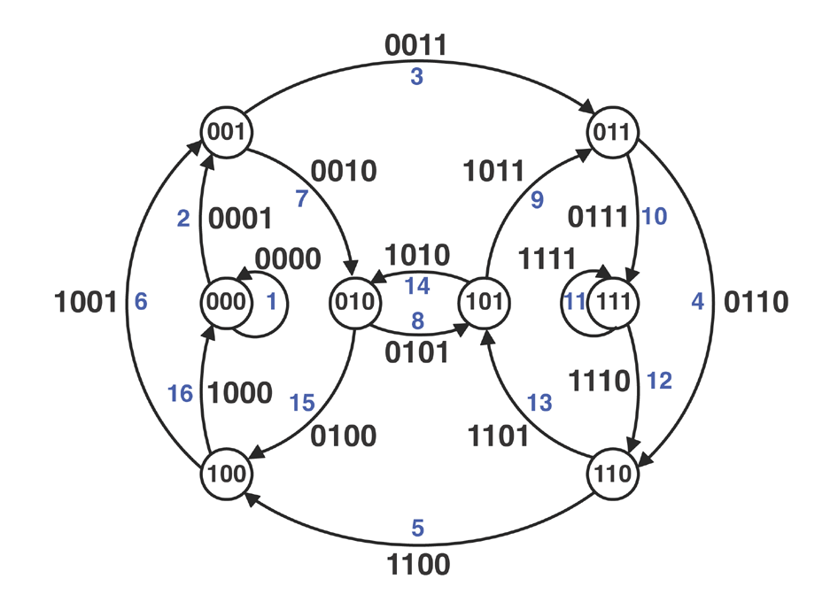
The Graph

Slide 21
DNA
Guanine (G), Adenine (A), Thymine (T), or Cytosine (C)

Slide 22
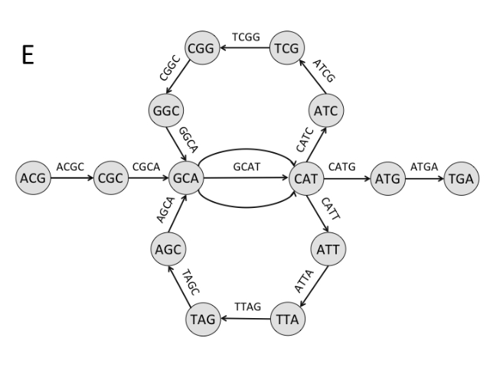

Slide 23
Enzyme Chop
ACGCATCGGCATTAGCATGA
Copy
Enzyme Chop!
ACG, CAT, CGG, CAT, TAG, CAT, CGC, ATC, GGC, ATT, AGC, ATG, GCA, TCG, GCA, TTA, GCA, TGA

Slide 24
AAA | ACA | AGA | ATA | AAC | ACC | AGC | ATC
AAG | ACG | AGG | ATG | AAT | ACT | AGT | ATT
CAA | CCA | CGA | CTA | CAC | CCC | CGC | CTC
CAG | CCG | CGG | CTG | CAT | CCT | CGT | CTT
GAA | GCA | GGA | GTA | GAC | GCC | GGC | GTC
GAG | GCG | GGG | GTG | GAT | GCT | GGT | GTT
TAA | TCA | TGA | TTA | TAC | TCC | TGC | TTC
TAG | TCG | TGG | TTG | TAT | TCT | TGT | TTT

Slide 25
AAA | ACA | AGA | ATA | AAC | ACC | AGC | ATC
AAG | ACG | AGG | ATG | AAT | ACT | AGT | ATT
CAA | CCA | CGA | CTA | CAC | CCC | CGC | CTC
CAG | CCG | CGG | CTG | CAT | CCT | CGT | CTT
GAA | GCA | GGA | GTA | GAC | GCC | GGC | GTC
GAG | GCG | GGG | GTG | GAT | GCT | GGT | GTT
TAA | TCA | TGA | TTA | TAC | TCC | TGC | TTC
TAG | TCG | TGG | TTG | TAT | TCT | TGT | TTT

Slide 27
For My next Trick

Slide 28
For My next Trick
Universal cycles a.k.a. U-Cycles
Three cards
Ask for suit
64 possibilities

Slide 29
Bell Number
B(n), the number of was n distinct things can be arranged into groups.
B(3) = 5
{A, B, C}
{A} {B, C}
{B} {A, C}
{C} {A, B}
{A} {B} {C}
B(4) = 15
B(5) = 52

Slide 30
The Trick?
Can you think of one?

Slide 31
The Trick?
Can you think of one?
Ask five people to group together by suit.

